Slide 1
Watson Solution Patterns Overview Equipment Repair /Maintenance
Business problem
Watson value proposition
Sample demo
Key client discussion points
Qualifying the client
Elevator pitch
Solution Architecture and Bill of Materials

Slide 2





Watson Equipment Repair/Maintenance
Telecommunications, Electronics, Airlines, Media Companies, Energy Providers & Utilities industries
Field Technicians are overwhelmed with information and lack an effective way to diagnose and resolve issues quickly, which impacts operational efficiency and CSAT
Internal Knowledge
Field Notes
Work Orders
Service Requests
Service Entitlement
Service History
Service Manuals
Knowledge Base
Collaboration Sources
Customer Data
Support
Forums
Web
Peers
Location
CRM
Eligible Offers
1
2
3
Aggregated Data Views
Cognitive Learning
Point of Impact Insights

Slide 3



Leveraging Watson specifically for equipment repair drives substantive value for clients while improving the technician experience
Reduce Operating Cost | Improve Customer Satisfaction | Increase Opportunities To Sell
First time fix rate
Cost/job savings
Service write-off savings
Warranty cost savings
Training cost savings
Unified Metrics/Improved Decisions
Customer Lifetime Value
Reduced Customer Churn
Improved information sharing
Part Sales
Warranty
Service Contracts

Slide 4
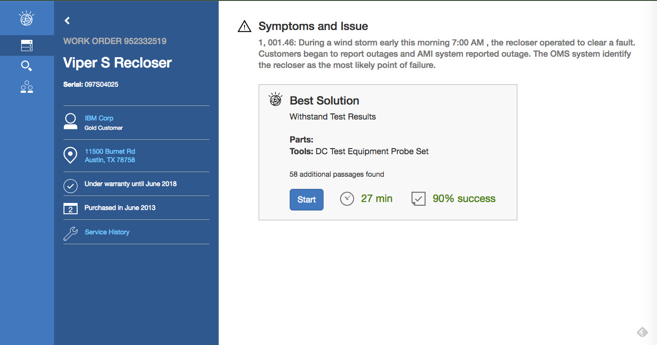
A live demo site for Equipment Repair/Maintenance (script in appendix)
Demo Link: equipment repair/maintenance
Username: wfsa-demo
Password: wfs@
EQUIPMENT SCOPE:
Energy & Utilities Reclosers
Copiers
Heavy Machinery
DEMO FUNCTIONALITY:
Workflow for a field technician executing a service call
Surfacing of best action resolutions
Retrieval of relevant passages (enhanced indexed search)
Field technician feedback / comments on service manual passages
Field Technician collaboration with Technicians and Supervisor

Slide 5
The Target buyer of Watson Field Technical Advisor is expected to be a COO at a larger electronics company with a need for multiple operating systems
Major Factors
Contributing Factors
Expertise Challenge
Machine
Complexity
Machine
Value
Business
Application Mgmt
Sales Revenue
Industry
Sub-segments
Expertise is leaving through retirement or attrition
Machines or technicians broadly dispersed
High turnover of technicians
Larger size of the software stack:
Drives potential conflicts or performance issues
Bugs, drivers, security and data throughput
Feature complexity
Circuitry and systems
Connectors, buttons, cameras – all with features behind
Machine value is high, downtime has dollar value or quality impacts to business operations
Equipment has longevity in the field
Has scheduled depreciation value
Company requires multiple operating systems
Techs use detailed questions and jargon
$1000MM/year – or at least 1000 technicians
Business Equipment (servers, document mgt)
Network Equipment Providers (communications equipment)
Power & Automation Equipment (elevators, injection modeling equipment)
*Sales revenue is a proxy for field technical force, assume 1000 techs for every B in revenue
Medical Device (may have compliance issues)
Consumer Electronics and Appliances (lower potential value to client)
Semi Conductor Mfg – (may be more difficult to meet specific needs with minimum viable product, price concerns)
Source: if applicable
Notes:
I would suggest that the general size of the software stack and product feature complexity are as or more important than the attrition or existing technical support people.
3 most important: Solution will not be able to stand without them, unless something from each of those categories is involved. Footnote: If a company has apple as their sole OS or wants to use it as their sole, there is another app that has been developed as their field service system thoruhg the apple IBM partnership, where as our solution could be sold to anyone: benefit of a broad customer base.
Machine complexity
Machine Value
Expertise Challenge

Slide 6
A checklist for sellers to qualify the client
Key Criteria |  | Optimal Candidates Look Like:
SPONSORSHIP: |  | Chief Operating Officer, Vice President Field Services (or Customer Service if combined), leaders that have the best span of control to make the decisions that drive success
EXPERTISE: |  | Clients experiencing challenges with retirement or geographic dispersal of techs; where turnover is a problem
MANY CONTENT SOURCES |  | The solution works best when marrying 6-8-10 solutions manuals, making it easy for techs to diagnose and define know the best solutions across multiple sources
BUDGET: |  | Being able to undertake a pilot is a great place but ensuring there is plan for broader roll-out up front drives faster adoption
MACHINE COMPLEXITY: |  | Does the client have significant or increasing complexity in machines, software and ecosystems/partner networks
FIELD FORCE SIZE: |  | Approximately 1,000 users or $1B in sales revenue
SPARE PARTS: |  | Companies that require multiple generations of parts (such as appliances) or high availability equipment (such as an MRI machine or robotic surgery arm) or fit for purpose (industrial equipment, semi-conductor production) in their machines will likely have inventory overstocks addressable with Watson.

Slide 7
Elevator Pitch
Field Technicians are often overwhelmed with information, lack an effective way to diagnose and can’t resolve issues quickly. This impacts company operations and satisfaction and drives potentially poor use of parts and resources.
This solution allows Field Technicians to tackle service requests execution more efficiently. They directly engage with Watson over a simple interface from diagnosis and chat, connecting to current internal systems for specific data.
Watson will help users fix problems the first time, reduce service write-offs, drive incremental revenue, and will greatly improve customer satisfaction overall.
FAQs
What is the client buying?
Prototype of Field Technician
A subscription to Watson Developer Cloud
How much does it generally cost?
$250K
How does the solution get implemented?
There are two options:
Build: 1 week enablement session for technical architects & developers
Buy: Hire system integrator
How long does it take?
2 weeks to build a prototype

Slide 8
Start NOW. Continue with intense focus and deep passion for success.
1.
Target solutions for your accounts
Review materials
Solutions Card
Seller’s Brief
Demo + Script
Customize your messaging and materials
Prepare your pitch
Practice using the demos
2.
Determine your client customization
Determine which patterns work best
Request customized demos for solutions most relevant to industry and account (SC number needed)
Determine data and content sources
3.
Conduct your meeting with confidence
Effective, well rehearsed demos (video alternatives)
Direct, relevant slides
Ability to move quickly to sales process
And please be sure to give us your feedback!

Slide 9
Solution Architecture and Bill of Materials
Note this solution can be proposed to the customer to be built on WEX + API’s (or) all Platform API’s. * in the list below indicates optional components.
Watson Framework
WEX Advanced
WCA Studio
App Builder
WKS integrated with WEX Runtime
Watson Platform (Bluemix)
Document Conversion (incl Data Crawler)
Retrieve & Rank
AlchemyLanguage (deploy the WKS trained models)
Visual Recognition *
Other Bluemix
Cloudant
Predictive Analytics *
Insights for Weather *

Slide 10
Appendix

Slide 11
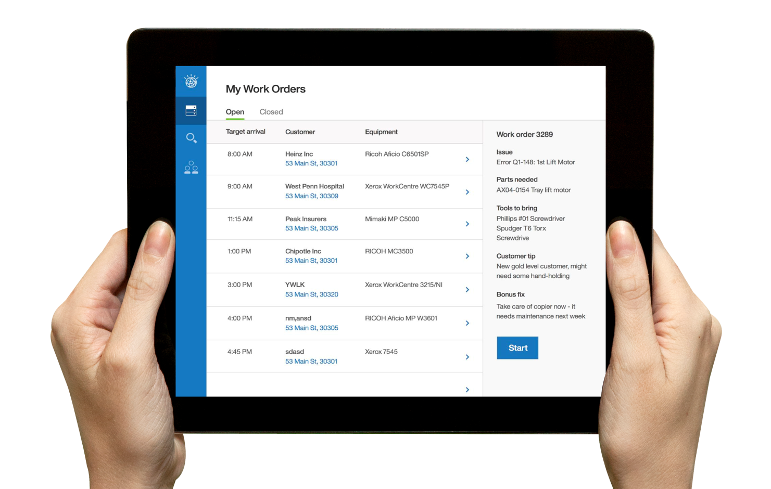
Intro
Demo Link: http://fieldserviceadvisor.mybluemix.net/FieldServiceAdvisor/main.html
Username: wfsa-demo
Password: wfs@
Credentials for chat (social tab): Username: wfsa.technician, Password: wfs@
For most customers, having faulty equipment accurately and reliably serviced drives satisfaction with a manufacturer.
When these machines require servicing, customers rely on a field technician to maintain the continuity of their business.
consistency and quality of expertise across an organization
difficult in an industry that’s constantly changing
increasing equipment complexity.
With Watson for Field Service, field technicians can drastically minimize the time spent diagnosing a problem and searching for a proper solution to a service call and improve their first-time fix rate, with fewer visits.
With a competitive environment that forces manufacturers to differentiate themselves with superior service, and so many variables involved in resolving a work order, empowering field technicians to make the right decisions without escalating to higher levels has become a necessity, here’s how a Junior Technician’s experience can be empowered:
l want to start my day by getting a bird’s eye view of orders that need to be fulfilled.
(Log in)
After logging in, I see a comprehensive list of all the orders that are still open, and I decide to get a more detailed view on my 8 o’ clock.
(Click on arrow to the right of the first order)

Slide 12
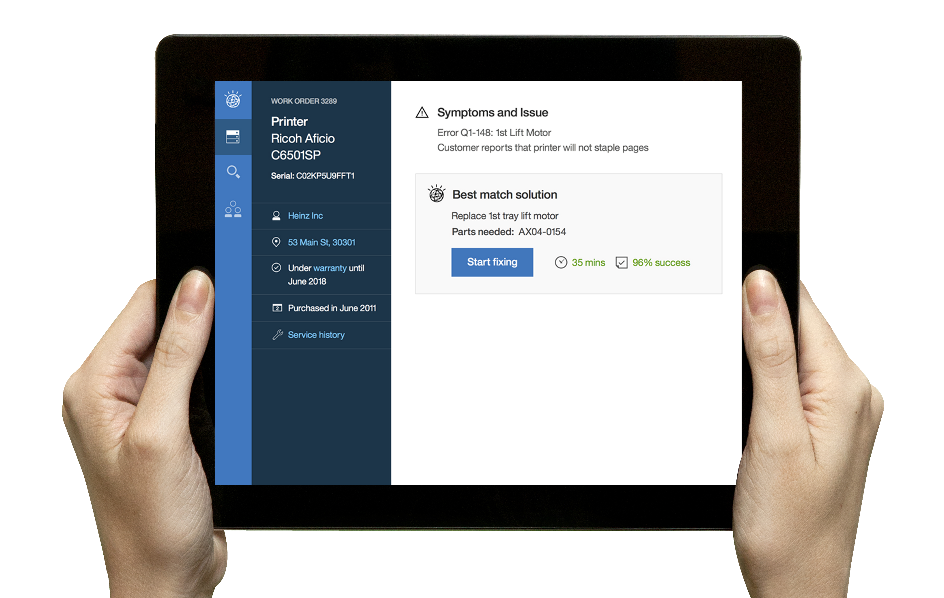
The context
(Here, I can see the key pieces of info I need to get this job done for Heinz: the issue, the parts and tools I need to bring, and even extra things that need to be done to fulfill this customer’s unique level or expectation of support. In this case, Heinz is at Gold level, so this technician had better get to work.
I arrive on site to fulfill the work order for Heinz, and I’m prepared to address the service request.
(Click “Start” button)
I’m brought to a fully comprehensive page detailing Heinz’s order. Here, I can see the equipment model, exact error, customer complaint, and service history.
Using information from service manuals as well as the symptoms reported by the customer, Watson provides me with a recommendation on how to fix this order, along with an estimate of how long it will take to finish.
However, I want to get an even more detailed view of the information Watson used to come to this conclusion.
(Click “Start fixing” button)

Slide 13
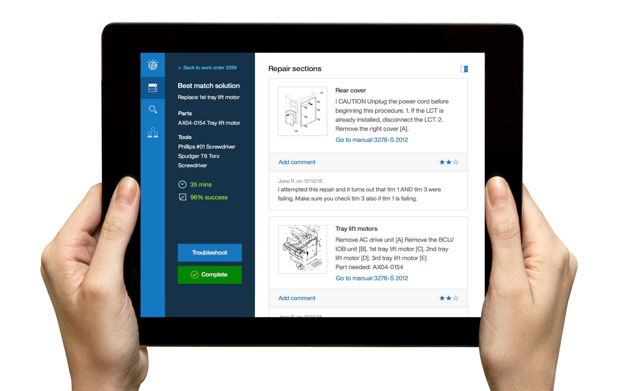
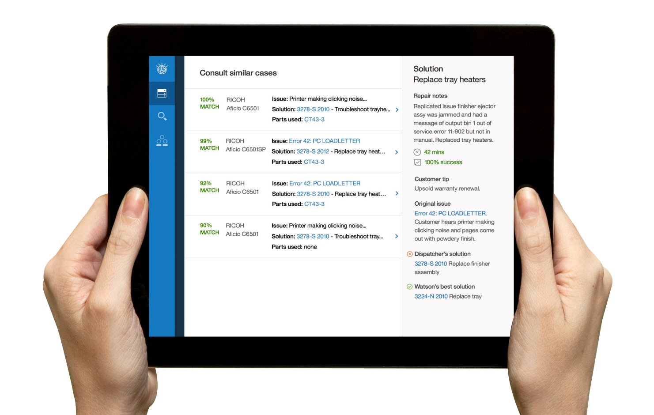
The diagnosis
Here, Watson shows me the exact passages from the relevant service manual or other sources it used as evidence for its suggestion. You can see that Watson can understand not only text, but images and diagrams as well.
I can even see comments and ratings from other technicians who used this procedure to supplement Watson’s recommendation. My input and rating for this procedure, along with other technicians’ will help further train Watson to provide accurate suggestions.
But let’s say for some reason, in this case, I’m sure this might not be the best action to take for Heinz’s problem. I can troubleshoot the issue to see my next best alternative.
(Click“Troubleshoot” button)
Watson provides me with a list of the next best options it thinks I can take to solve Heinz’s order, ranked by confidence. It uses cases from prior work orders that are relevant or similar to the issue I am dealing with right now.
Using the service history, Watson behaves the same way that a senior engineer or expert-level technician would, taking all the information available, as well as depth of “experience” to help inform the best route to resolving a problem.
However, if I wanted to dig a little deeper into the problem, I can do a natural language query:
(click search icon)

Slide 14
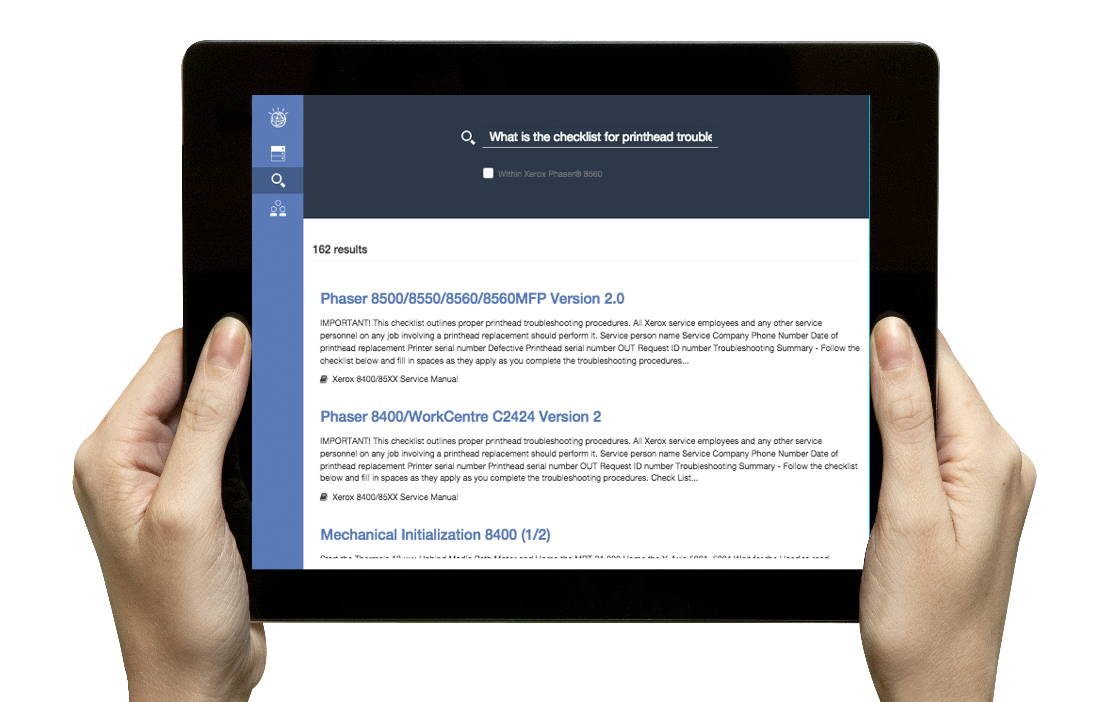
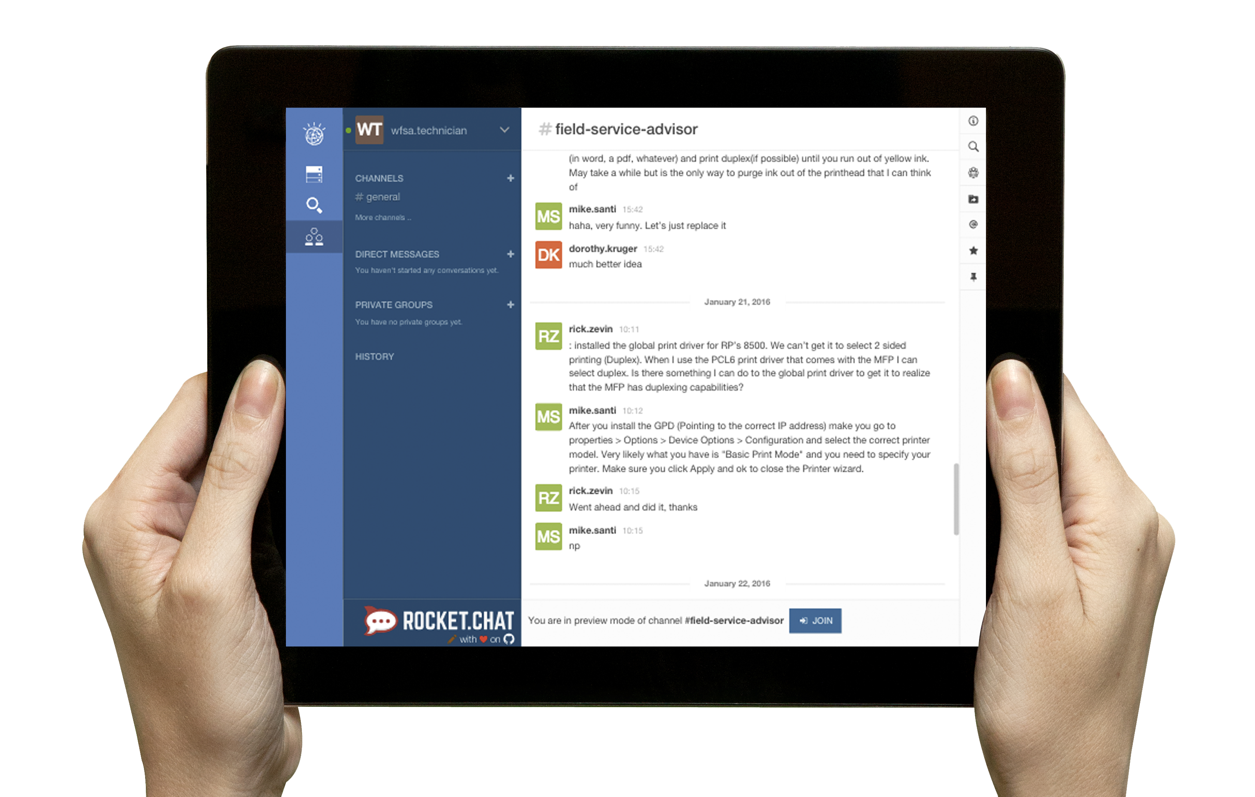
NLC
(Search “What is the checklist for printhead troubleshooting?")
Here I can see more information related to the issue I’m dealing with. Again, this information is derived from the manuals and procedures that have proven successful with this issue. However, this feature is used only when the prior two steps did not produce the proper solution, which is highly unlikely.
If I wanted a second opinion, I can open up the chat log and view what’s been said about the issue, while providing my own input to my peers
(click social icon on left, and type in credentials:
Username: wfsa.technician
Password: wfs@)
­­­­­­­
­­­
Here I have all the chats between myself and other engineers that have worked on problems like this as well. I can view what’s already been said, or I can communicate with them directly if they’re available. Even the input from the administrative and senior levels are included.
Armed with these tools to navigate the sea of knowledge that goes into field service, every technician can be an expert.

Slide 15
Executive
Director of Operations Demo Script
Link: http://doo-dashboard.mybluemix.net/main.html
Username: wfsa-demo
Password: wfs@
Complex equipment is never static. Throughout their lifetime, they continuously require repair, modification, and even reinvention. Because of this, large equipment manufacturers have to have full visibility into the performance of their customers’ machines so they know what is happening, where it’s happening, and how they can change it to prevent it from happening again. However, it is difficult to look at and analyze all the relevant data at one time. It’s difficult to make sense of the data and draw parallels of seemingly disjointed problems.
With Watson for field service, a director of operations can gain a bird’s eye view of all the touch points from the field level. This aggregated view allows him to easily spot patterns that will allow him to accelerate the product redesigning process so future iterations will experience fewer issues.
With a competitive environment that forces manufacturers to differentiate themselves with superior products and service, and with so many variables that that can go into a product’s servicing cost, empowering directors to make the right operational decisions has become more than just a “nice to have”; it’s become a necessity.

Slide 16
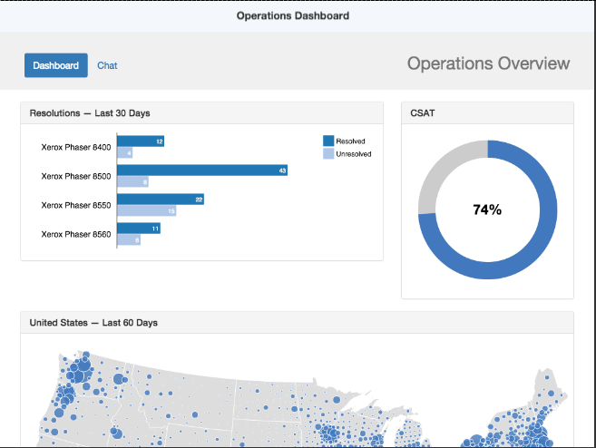
Understand Service Call Drivers
So I’m a director of operations at Xerox who wants to get an overview of where the company stands with regard to our customers. After logging into the application, I immediately have a general idea: customer satisfaction stands at around 74%.
(Start hovering mouse over the bar graph)
I can also see which of our products have received the most servicing: in this case, it looks like the 8500 model printer, but the vast majority of those service calls were resolved. Now that I know that the 8500 is receiving a lot of service calls and that the problem is easily fixable, maybe I can get the design team to look into it to make sure the next version of the 8500 doesn’t experience the same issue.
(Scroll down to map)

Slide 17
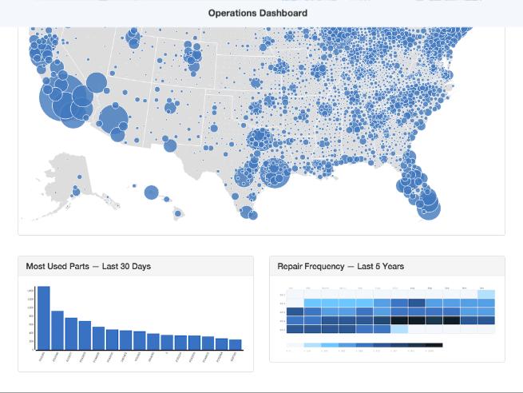
Dive into detail
I can also look into which parts are being ordered the most for these repairs so we can make sure we are never in shortage of the parts most needed or buying too much of the ones we don’t need.
(Hover over part usage graph
Just as importantly, I can even see the frequency of repairs for certain models. Combined with the other information, I can make suggestions to the design and product teams to ensure future versions of printers that use this type of part need to be modified.
(Hover over repair frequency map)

Slide 18
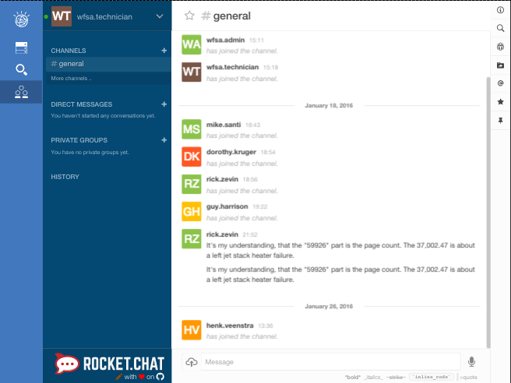
See relevant discussions
(Click on “chat” tab
log in credentials:
Username: wfsa.technician
Password: wfs@
click on general)
I can even see what my engineers are discussing when out fixing these models, and find out which issues are more frequently being discussed, while speaking with them directly. Verifying the issues I spotted from the dashboard with my technicians makes the process more collaborative, and the product improvement more accurate.

